Slide 1

Summer book recommender
Jordi Díaz Carné

Slide 2
Project Overview
GoodReads_100k_books.csv
Original dataset: 100.000 rows × 12 columns
Title | Author | Bookformat | Genre | Description | Image
ISBN | Link | Pages | Review | Rating | Total Ratings
Notes:
Which topic did you choose and why?
Briefly describe the original dataset and the hypothesis you formulated.
Explain the structure and process of your data cleaning and analysis.
Highlight any unique data cleaning techniques or methods you’ve employed.

Slide 3
Data Wrangling and Cleaning
genre=Nonfiction, Environment, Nature, Travel, Science, Autobiography, Memoir, History, Science, Natural History, Animals, Science Nature, Animals, Birds
genre_1=Nonfiction
genre_2=Environment
genre_3 = Nature
265 genres
18 genres
Notes:
Discuss the significant data cleaning challenges you encountered (missing data, duplicates, formatting issues, etc.).
Explain how you used APIs and web scraping to collect and enrich your dataset.
Explain how you resolved these challenges.

Slide 4
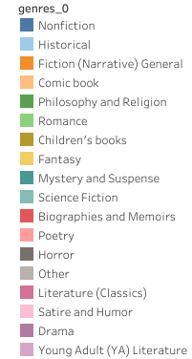

Exploratory Data Analysis
Notes:
Discuss the exploratory data analysis methods you used.
Share insights and interesting patterns you found.

Slide 5
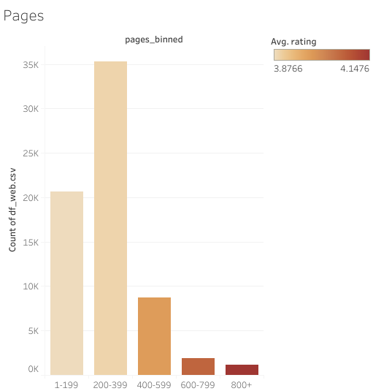
Number of books according to the pages they have
Notes:
Discuss the exploratory data analysis methods you used.
Share insights and interesting patterns you found.

Slide 6
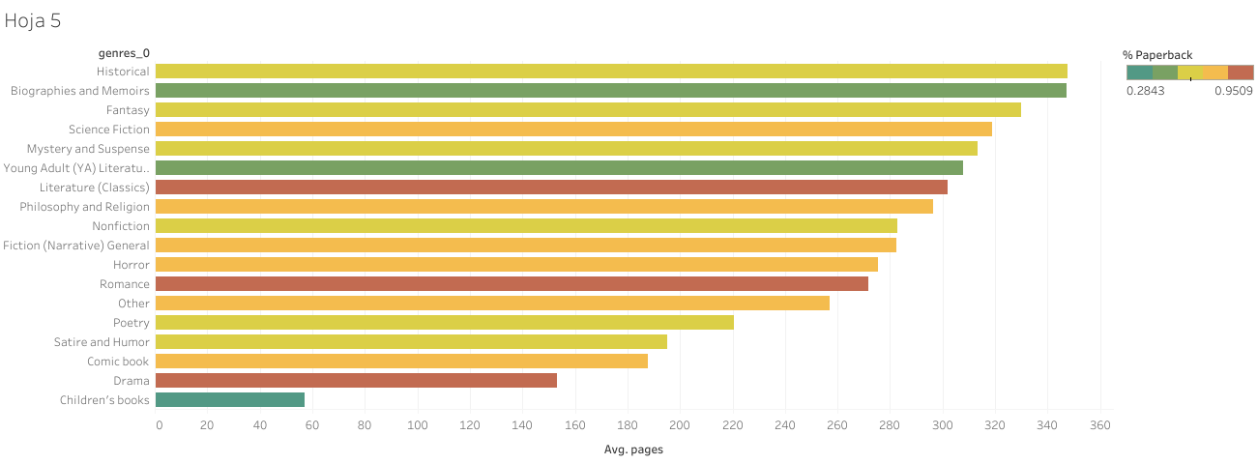
Number of pages for each genre
Notes:
Discuss the exploratory data analysis methods you used.
Share insights and interesting patterns you found.

Slide 7

Streamlit turns data scripts into shareable web apps in minutes.
All in pure Python. No front‑end experience required

Slide 8
Design the interface
The Backend
This is the code that runs on the server side, handling the logic of the application. It is responsible for managing interactions with the database, processing data, and performing the core functionalities of the application.
The Frontend
It’s what the users see and interact with, consisting of the layout, design, and interactive elements that enable users to perform tasks within the application.

Slide 9
Now let's check the website
https://summerbookrecommender.streamlit.app/

Slide 10
Pros and cons of Streamlit
STREAMLIT is a very useful tool if you want to make an interactive dashboard instead of using TABLEAU
Greater freedom and therefore greater possibilities of carrying out your ideas
Greater complexity and therefore probably more time you will invest
Possible problems linking GITHUD and STREAMLIT

Slide 11

Major Obstacles
Learn how to use Streamlit
Group 265 book genres into 18
The time allocated to achieve an attractive design
Problems deploying the website with GitHud due to exceeding the bandwidth
Notes:
Discuss the biggest obstacle or mistake you encountered during this project.
Share what you learned from it and how it influenced your project.
Is there anything you would do differently in hindsight?

Slide 12

Conclusions
The most popular books are those that have less than 400 pages
Curiously, the books best valued by readers are those with the most pages
If we want a light book with a paperback format to go to the beach, it would be best to opt for a drama or romance book
Notes:
Discuss whether your initial hypothesis was supported or refuted.
Share main learnings and any surprising insights or findings.
Discuss potential implications of your findings.
Where there any questions you couldn’t answer?

Slide 13

Thank you for your time!
Jordi Díaz Carné

